Slide 1



Kendo UI and Angular
The Ninja teaches html5 new tricks
Jeremy Likness
Principal Architect
@JeremyLikness

Slide 2
Kendo UI and AngularJS
What is AngularJS?
Why would I use AngularJS?
How does AngularJS work with Kendo UI?
Directives walkthrough
Conclusion, Q&A

Slide 3
What is AngularJS?
Single Page Application (SPA) framework
Expressions – parsed right from the DOM
Data-binding – glue between presentation logic and your UI (MVVM)
Container – dependency injection
Templates – repeatable UI and behavior
Tools – logging, REST calls, animations, journaling, and more
Testable – it even has it’s own mock library
See: http://csharperimage.jeremylikness.com/2014/10/a-different-angle-what-is-angularjs.html

Slide 4
DEMO TIME!
Hello, Angular World

Slide 5
What We Learned
You can write an Angular app FAST
Angular takes away a lot of your ritual and ceremony
Modules are containers for Angular apps
Services are reusable components
Controllers are special services used for data-binding
Directives extend HTML’s vocabulary
Filters provide consistent transformation of data to information

Slide 6

Why would I use AngularJS?
It removes pain
Case study:
25 developers
80,000+ lines of TypeScript code
200+ components
3 years
Global parallel development team
4x improvement

Slide 7
How does AngularJS work with Kendo UI?
jQuery “normalizes” the DOM
Kendo UI is built on top of jQuery
AngularJS doesn’t require jQuery but uses it when present
Directives are the “glue” between Kendo UI and AngularJS
Browser
jQuery
AngularJS
Kendo UI

Slide 8
Kendo UI Core – It’s Free Open Source
http://www.telerik.com/kendo-ui/open-source-core
Dozens of Widgets
Mobile Controls
Framework Features:
DataSource
Drag and Drop
Globalization
Touch & more …
Angular support is included
Or go professional, and get …
BarCode
Charts
Editor
Gauges
Grid
Map
Scheduler & more …

Slide 9
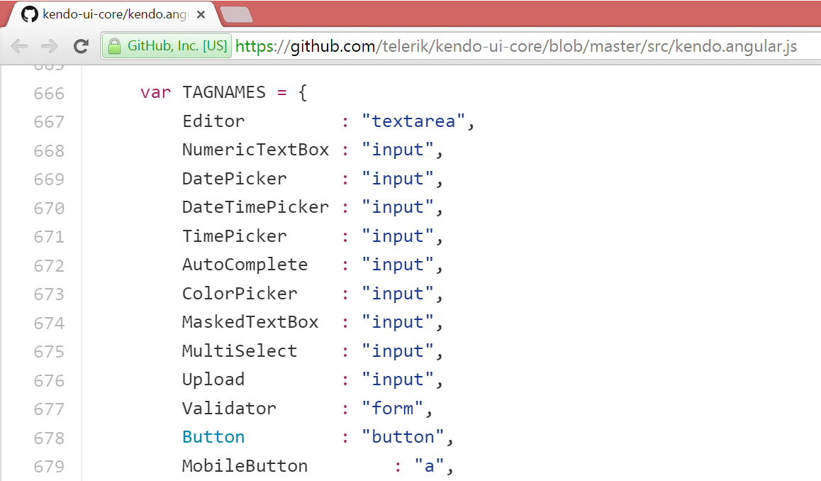
How does AngularJS work with Kendo UI?

Slide 10
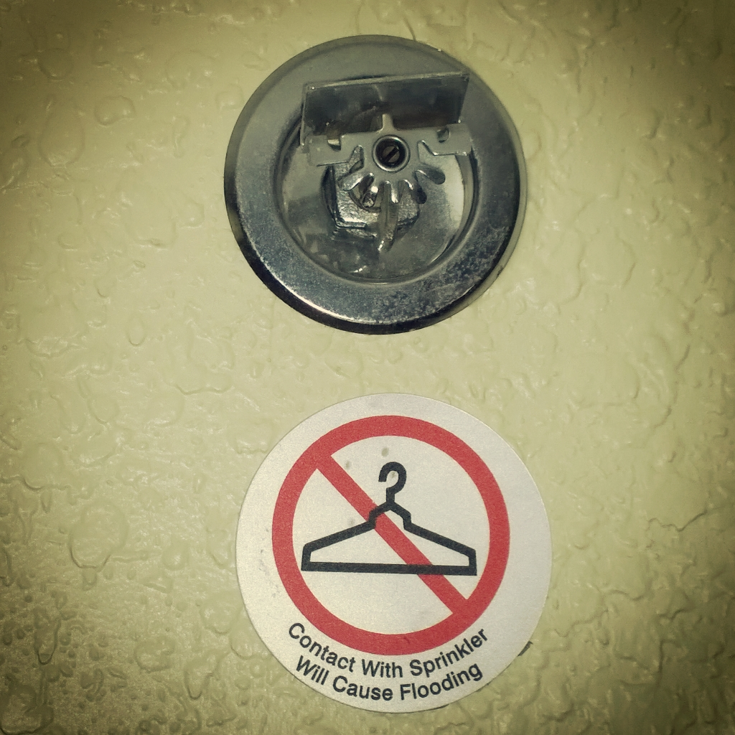
What won’t AngularJS use from Kendo UI?
MVVM – Angular has it’s own
Router – Angular has it’s own routing (ng-route, ui-router)
View/Layout – Angular uses it’s own views (ngView, uiView)
Otherwise it’s pretty much “sky is the limit”

Slide 11
DEMO TIME!
Kendo UI Angular Directives

Slide 12
What We Learned
If Jeremy sat around all day and did absolutely nothing he would still burn around 1,930 calories
They say it isn’t fair: women burn fewer calories at rest than men with a similar height and weight
Angular and Kendo UI work together seamlessly
Kendo UI provides built-in directives
Use kendo-widget-name to drop in a Kendo Widget
Use k-widget-property to set Widget properties

Slide 13
BONUS DEMO
The Rate Grid, Refactored

Slide 14
Questions, anyone?
How’s My Driving?
http://bit.ly/next-likness-2
Jeremy Likness
@JeremyLikness
http://bit.ly/coderblog
http://github.com/jeremylikness/telerikNEXT2015/

